Slide 1


South Korea
Study Tour Abroad 2023
16/07/2023 - 08/08/2023

Slide 2
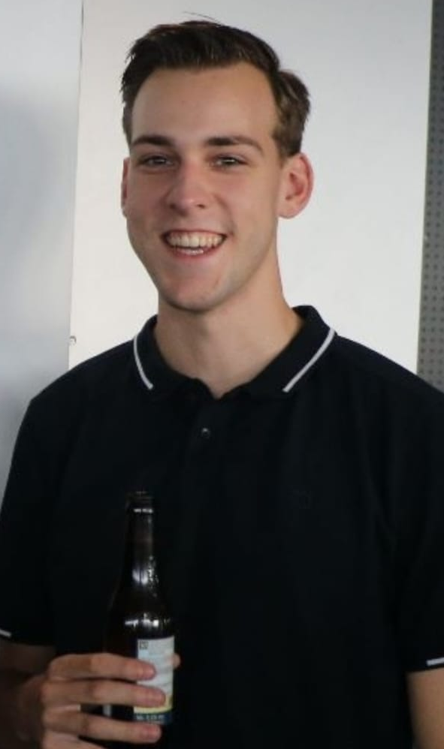
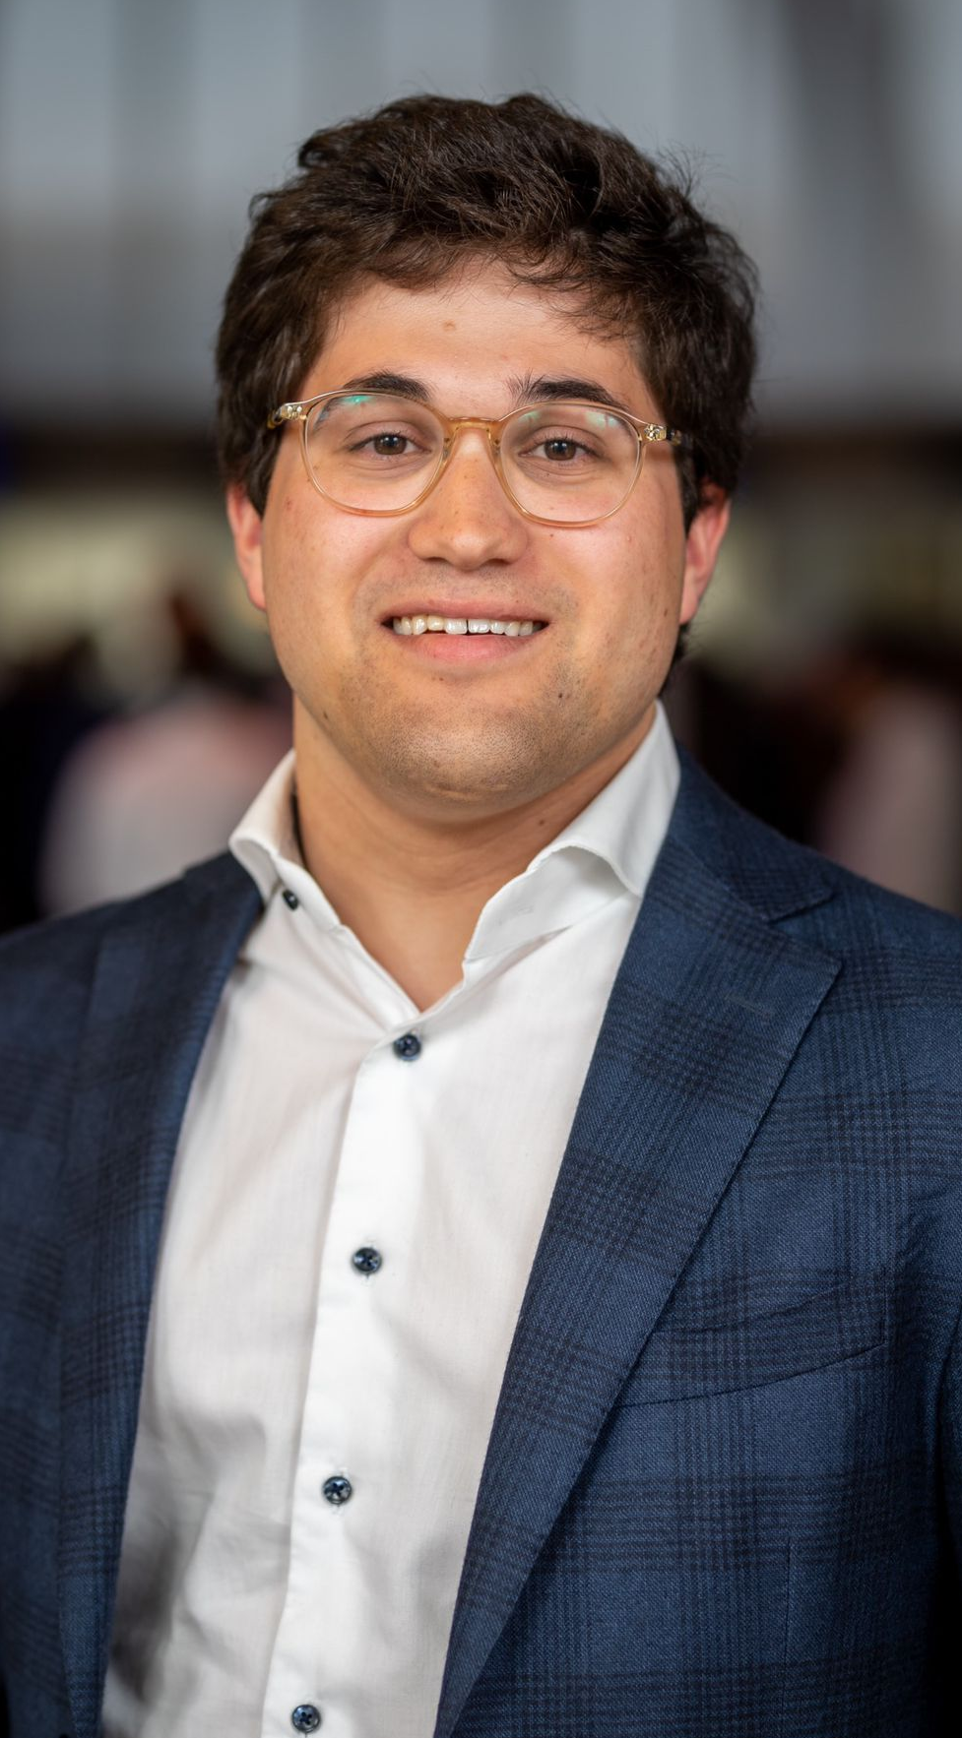
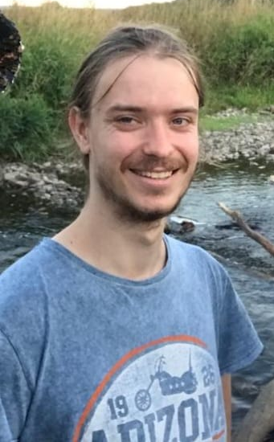
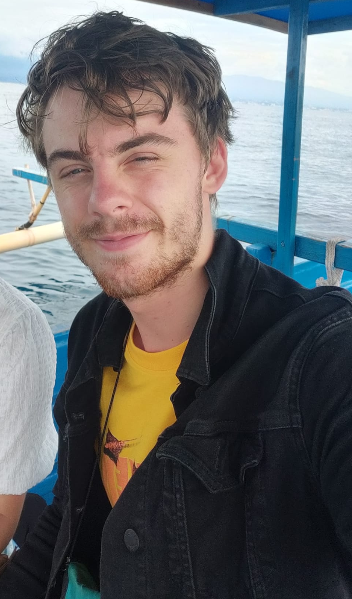
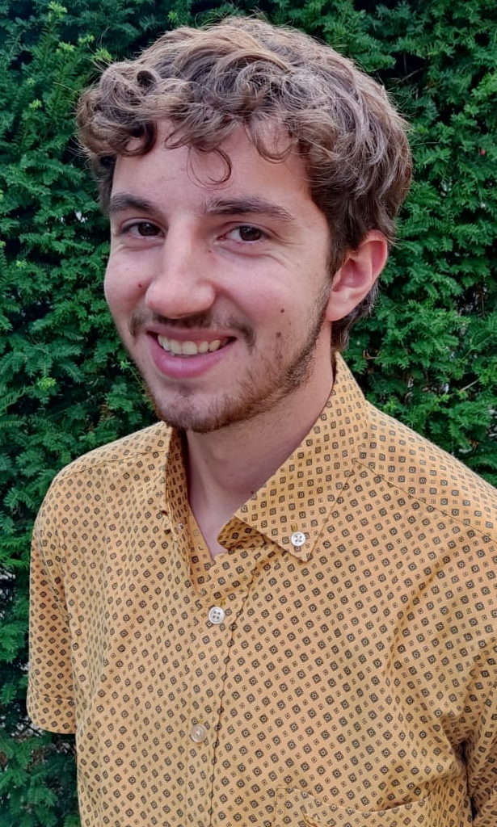
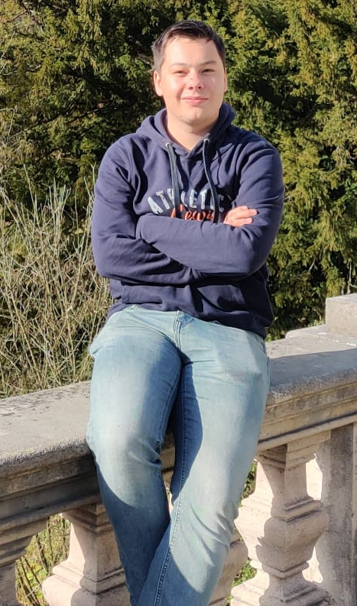
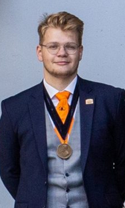
Meet the committee

Slide 3
How the Study Tour Abroad works
Relatively cheap trip to an interesting country
Travelling with a group of students and a scientific supervisor
Nice mix of interesting science, culture and free time
Access to otherwise inaccessible institutes/companies
You are required to attend all (pre-) excursions, both scientific and cultural
Fun!

Slide 4
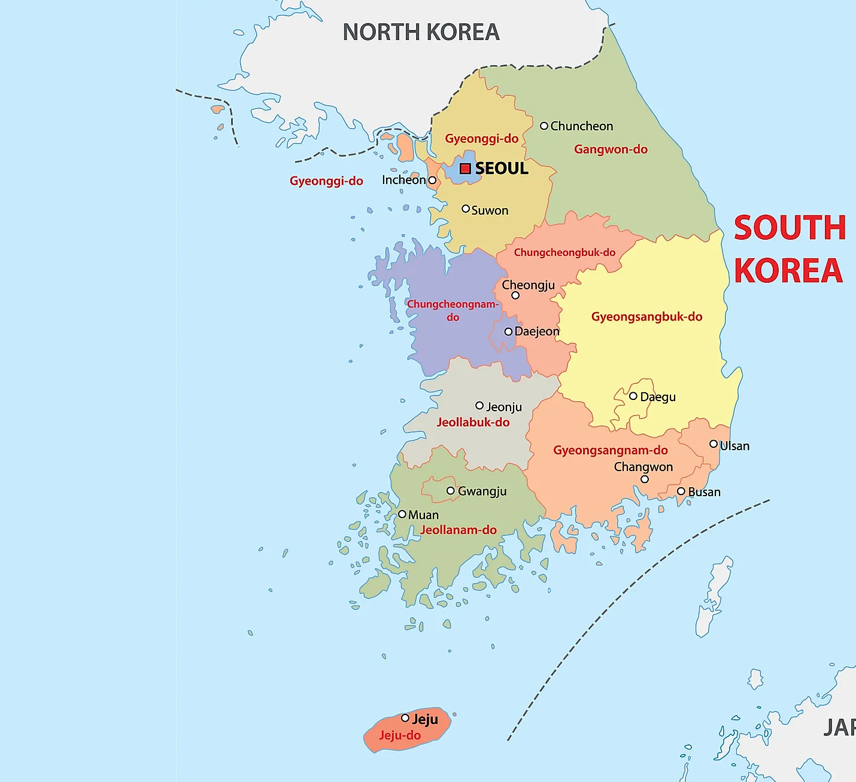
The Trip
Fly to Incheon airport on 16/07
Stay in Seoul 5 nights (17/07-22/7)

Slide 5
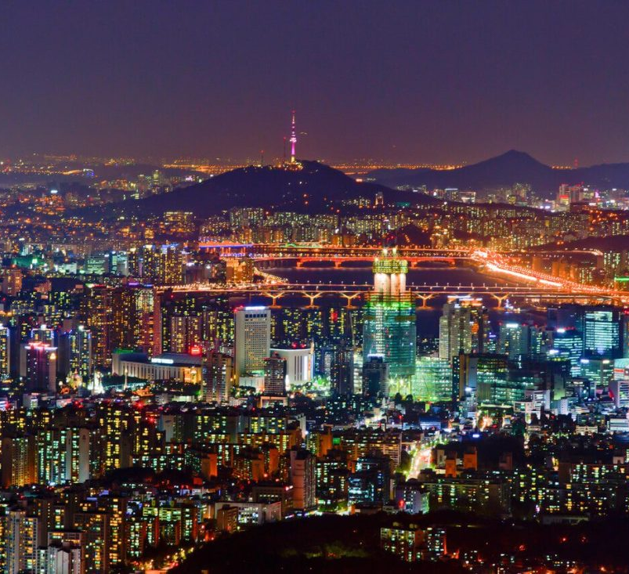
Seoul
Science
      Radar observatory
      Seoul National University of Science and Technology
      Companies like Samsung/DI corporation
      Culture
      DMZ tour
      Bukhasan national park
      Templestay
      Gyeongbokgung

Slide 6
The Trip
Travel to Daejeon
Stay 4 nights (23/7-26/7)

Slide 7
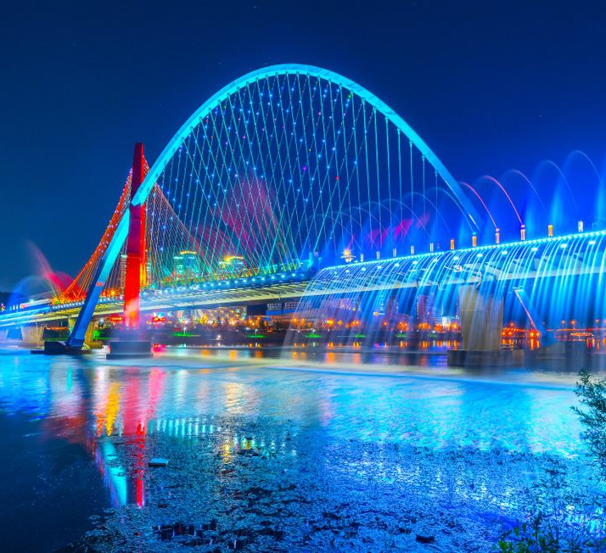
Daejeon
Science
      Korean Advanced Science Institute
      Korean Institute of Fusion Energy
      Daeduk university
      Culture
      Uam historical park

Slide 8
The Trip
Travel to Jeonju
Stay 1 night (26/7)

Slide 9

Jeonju
Culture
      Food capital of Korea
      Hanok village

Slide 10
The Trip
Travel to Mokpo
Take the night ferry to Jeju
Stay 3 nights (28/7-31/7)

Slide 11
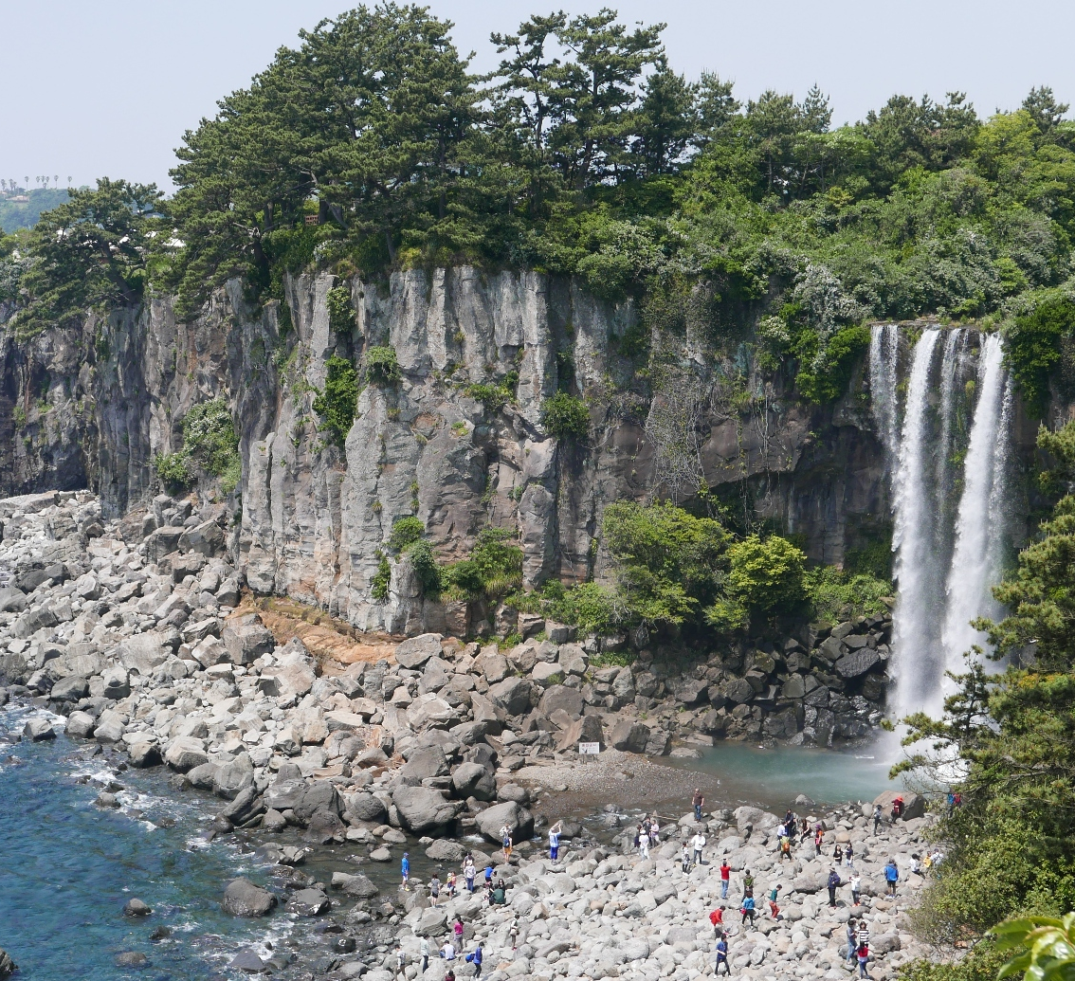
Jeju
Science
      KITECH
      Jeju national univeristy
      Culture
      Beautiful nature
      Hallasan
      Manjanggul cave

Slide 12
The Trip
Take the night ferry to Busan
Stay 4 nights (1/8-4/8)

Slide 13
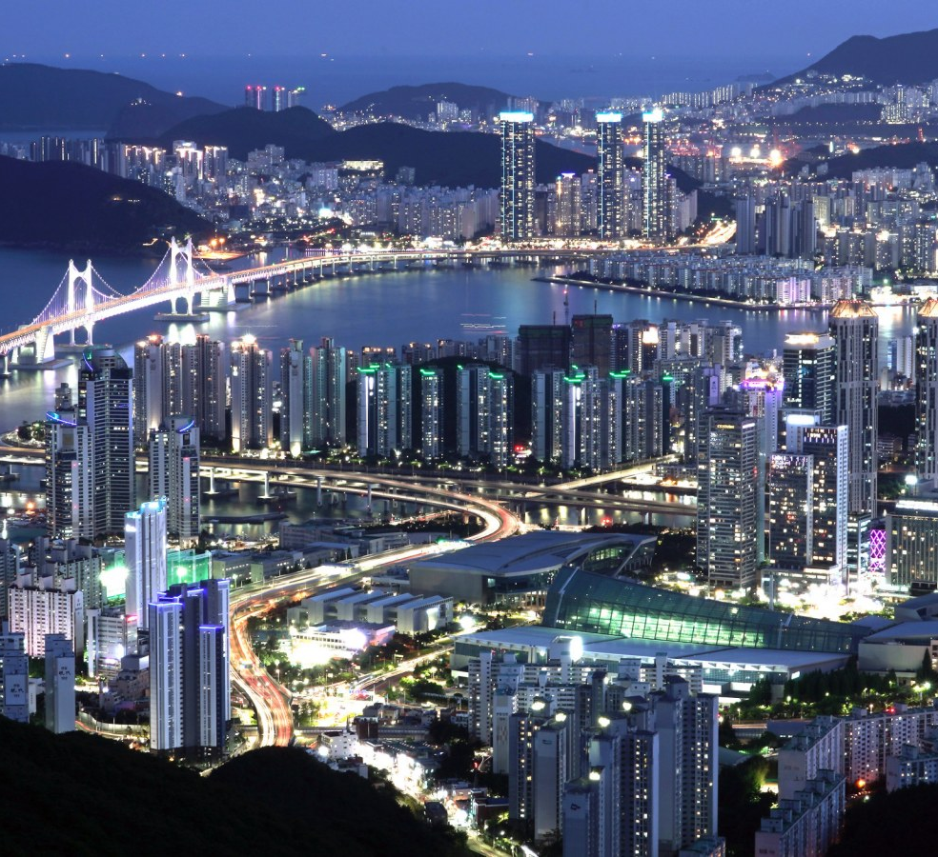
Busan
Science
      Busan institute of science and technology
      Korean institute of ocean science and technology
      IBS centre for climate physics
      Culture
      City tour
      Jagalchi fish market

Slide 14
The Trip
Travel to Seoul
Stay 3 nights (5/8-7/8)

Slide 15

Cases
Opportunity to work for a company
        20-80 hours in Q3/Q4
Decrease the prize of your trip
Between 4 and 8 participants
Everyone has to apply in the application procedure
In contact with companies but no confirmed cases, further information will follow after the subscription period has ended

Slide 16
Practical information
16/07/2022 - 08/08/2022
Working on cases
Everyone has to apply if a case takes place
Multiple pre-excursions and business cases
The participants contribution is €2500,-
This includes:
- Travel costs including plane tickets
- Accommodation in the 5 cities
- Planned cultural and scientific excursions
- Participant clothing
- Meal on the last day

Slide 17
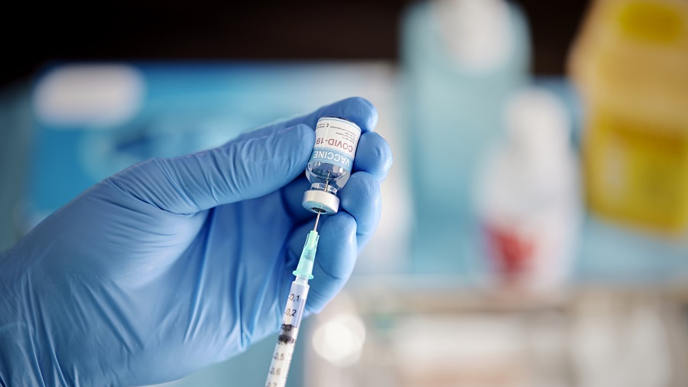
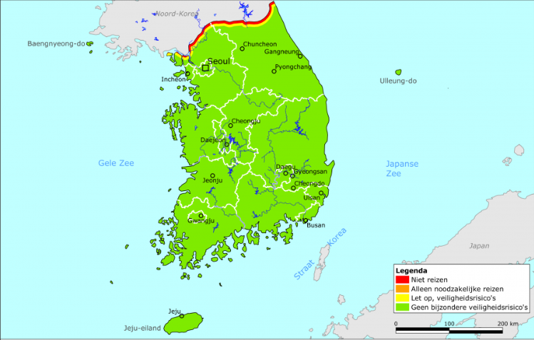
Covid-19
Situation has improved
Green travel advice
Barely any travel restrictions (no pcr test needed)
Some documents needed
Vaccines might be necessary
Masks in indoor areas

Slide 18

Interested?
Subscriptions are open from 29th of November until December 13th
You have to:
Fill in the registration form
Make a deposit of 300 euros to NL86INGB0008035504
Hand in a copy of your passport and sign a registration form.
The maximum number of participants is 24 incl. the committee. If there is a need, lots will be drawn on December 14th
The rest of the amount will be paid in terms.

Slide 19


Questions?
For any other questions, it is always possible to send an email to either:
buex2023@vdwaals.nl
Or
danny@vdwaals.nl

