Slide 1
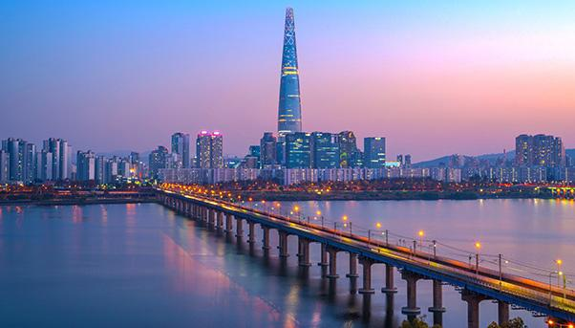
South Korea
Study Tour Abroad 2022
13/07/2021-05/08/2021

Slide 2
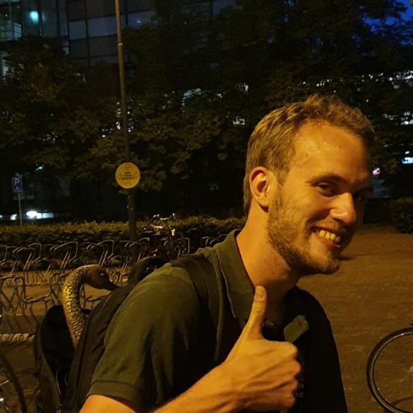
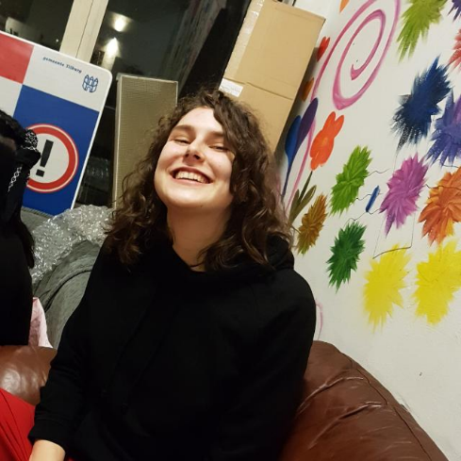
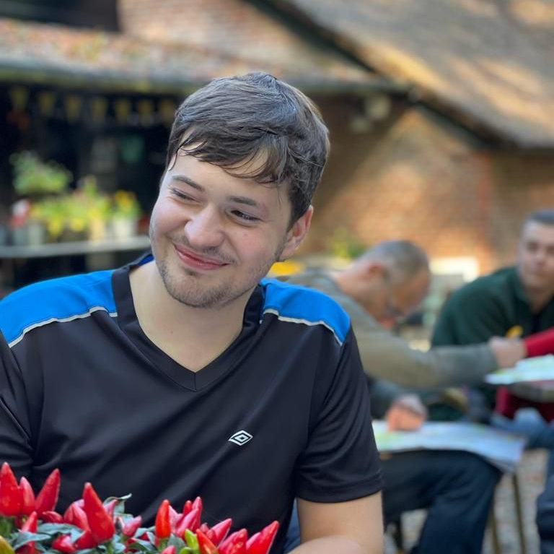
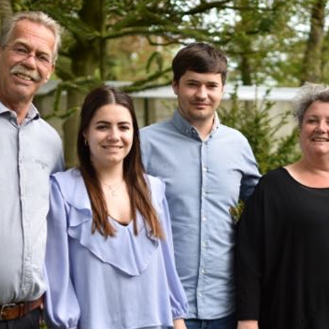
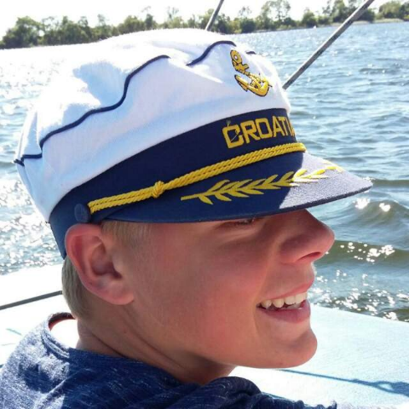
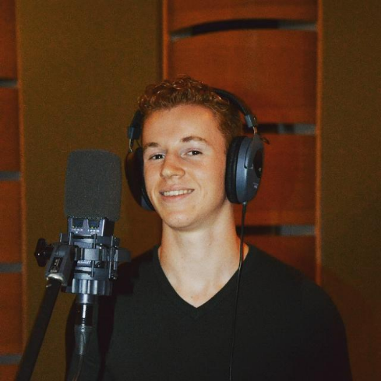
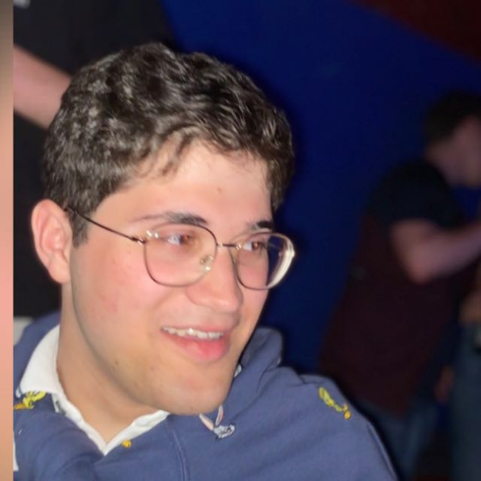
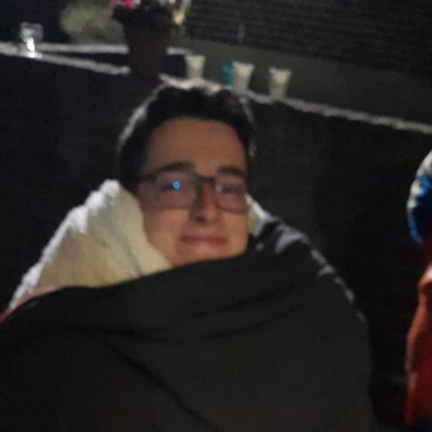
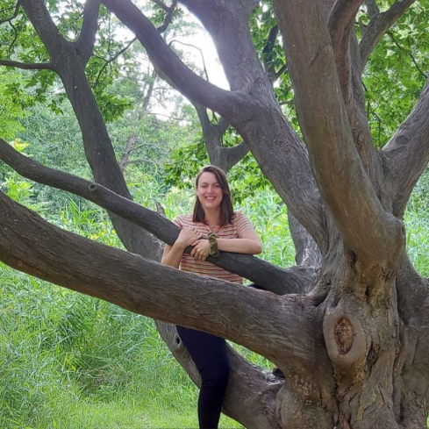
Meet the committee!
Bas van Dijck
Eline Boom
Joris Vonk
Max van Hemert
Menno Smeets
Mick Gielen
Thijs Vernooij
Vera Mark

Slide 3
How the Study Tour Abroad works
Cheap holiday with a mix of Science, Culture and free time
Each element is 1/3rd
Goal is to enrich scientific and cultural views and knowledge
You are required to attend all (pre-) excursions, both scientific and cultural
The most important goal however is to have fun!

Slide 4
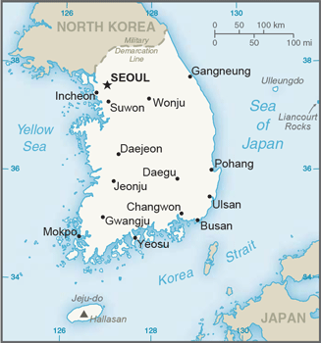

The trip
Fly to Incheon Airport on 13/07/2021
Stay in Seoul
14/07-19/07

Slide 5

The trip
Travel to Deajeon on 19/07
Stay in Daejeon from 20/7-21/07

Slide 6
The trip
Travel to Gwangju on 22/07
Stay in Gwangju from 22/07-24/07

Slide 7

The trip
Travel to Jeju on 25/07
Stay on Jeju on 25/07-28/07

Slide 8
The trip
Travel to Busan on 29/07
Stay in Busan on 29/07-01/8

Slide 9
The trip
Travel back to Seoul on 02/08
Stay in Seoul on 02/08-04/08
Fly back from Incheon Airport on 05/08/2021

Slide 10
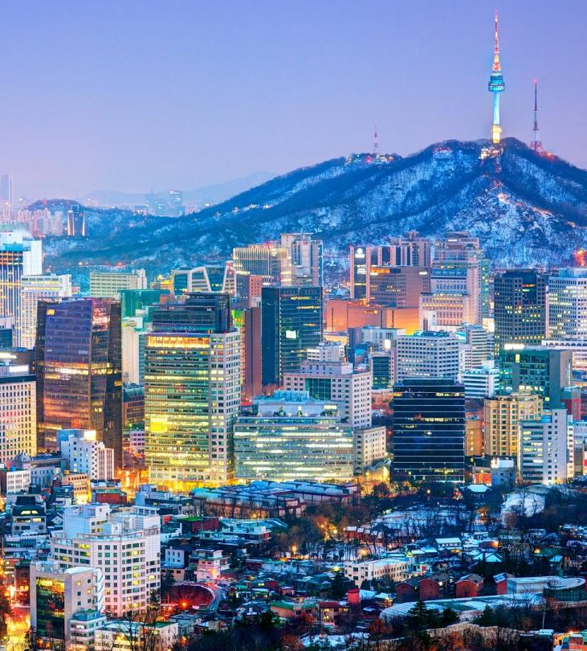
Seoul
Science
Seoul National University of Science and Technology
Companies like Samsung/CrucialTec
Cultural
Bukhansan National park
Historical Center
DMZ Tour
Templestay Seoul

Slide 11
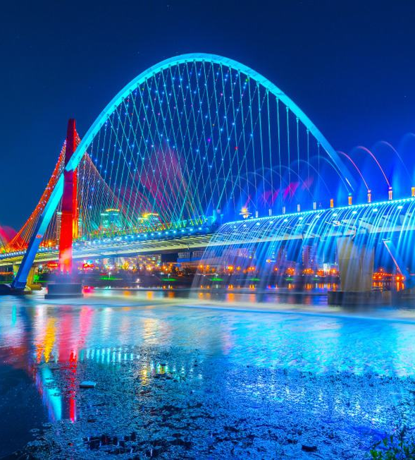
Daejeon
Science
Korea Advanced Institute of Science and Technology
Korea institute of Fusion Energy
Korea Astronomy and Space Science institute
Atomic Creative Technology
Cultural
Uam historical Park

Slide 12
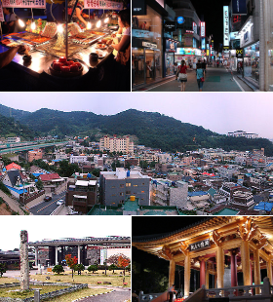
Gwangju
Science
MTEK
Gwangju Institute of Science and Technology
Culture
Mudeungsan park
Soswaewon garden

Slide 13
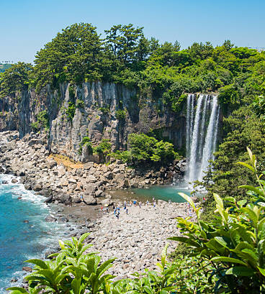
Jeju
Science
Jeju National University
DAEEUN
Culture
Beautiful nature

Slide 14
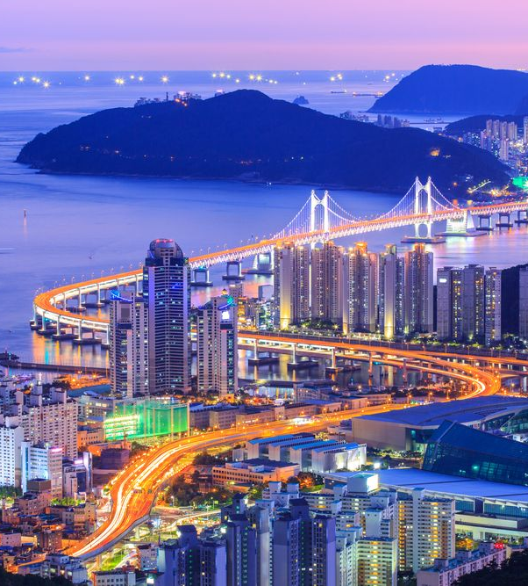
Busan
Science
LEENO
Korea basic science institute
Busan Institute of Science and Technology
Pulsan National University
Culture
Beaches!
City tour
Temple: Haedong Yonggunsa

Slide 15
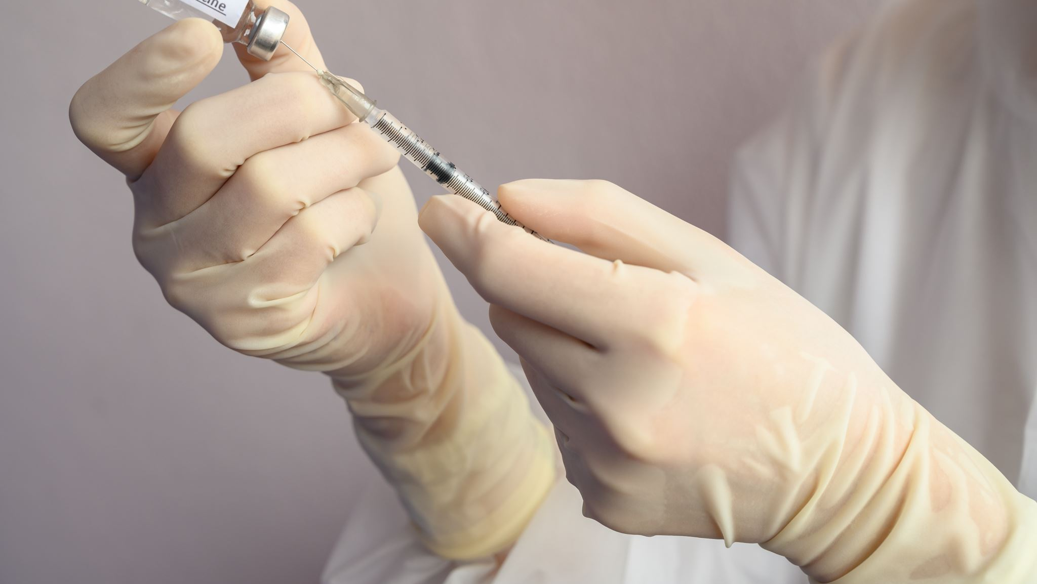
COVID-19
- We monitor the COVID-19 situation regularly
- Vaccines are highly likely required to enter the country
- Traveling with travel agency means cheap and beneficial cancellation terms to a late date
- Contact with embassy
- First go/no go moment January 11th

Slide 16
Cases
Opportunity to work for a company
  20-80 hours in Q3/Q4
Decrease the prize of your trip
Usually around 4 participants
Everyone has to apply in the solicitation procedure
Currently still working to get the cases arranged in time

Slide 17
Practical Information
13/07/2022-05/08/2022
Working on cases
  Everyone has to apply if a case takes place
Multiple pre-excursions and business cases
The participants contribution: € 2100,-
Includes
  Travel costs including plane tickets
  Accommodation in the 5 cities
  Planned cultural and scientific excursions
  Participant clothing
  Meal on the last day

Slide 18
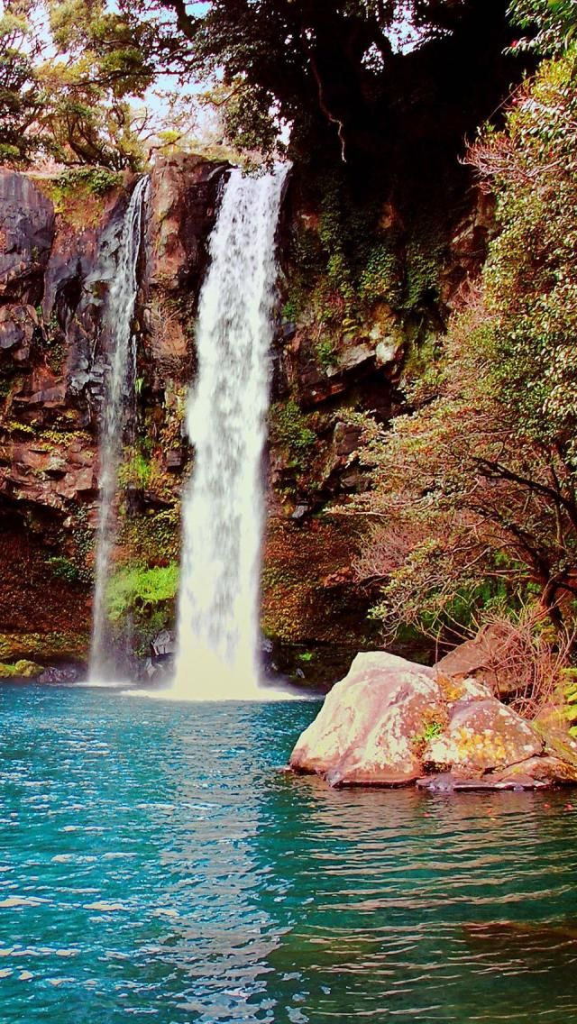
Interested?
Subscriptions open from December 7th until December 22nd
You have to:
- Fill in the registration form
- Make a deposit of 150 euros to NL86INGB0008035504
- Hand in a copy of your passport and signed registration form in the vdWaals room.
- Receive a copy of the signed registration form
The maximum number of participants is 24 inc. the committee. If there is a need, lots will be drawn on December 23th
The rest of the amount can be paid in terms.

Slide 19

Questions?
For any questions, it is always possible to send an email to either:
buex2022@vdwaals.nl
Or
Bas@vdwaals.nl

